Slide 1
Shift-Left Security:
More than just a catchphrase
Vince King
March 2023
Notes:
Shift-left Security: More than just a catchphrase
Vulnerabilities like Log4j may be headline grabbers, but thousands of applications are being targeted by hackers who use flaws in code as attack vectors. Vulnerabilities such as cross-site scripting and improper authorisation are on the increase, and with the increased use of open source software we need to ensure "shift-left security" is more than just a catchphrase.
During this presentation we'll look at:
- what modern development looks like
- what developers want
- what developers actually need
- what IT professionals should look for in DevSecOps tooling and how it can help

Slide 2
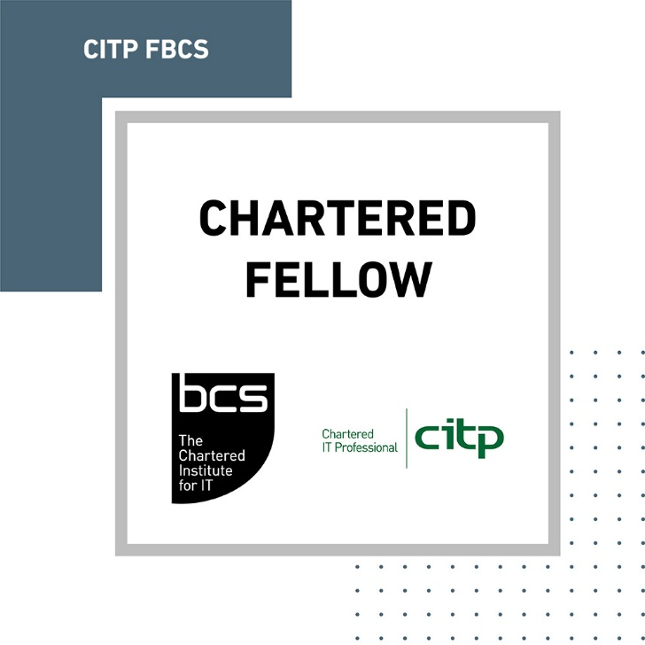






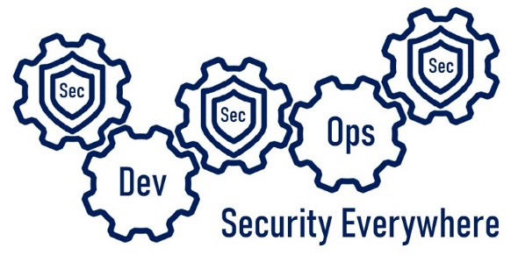

#whoami
Vincent King
Senior Cyber Analyst
Head of DevSecOps
Bank of England
Reformed Developer
Secure Coding Subject Matter Expert
(ISC)² Certified Information Security Professional
Chartered Fellow of the BCS
DevSecOpsVince
vincentjking
Notes:
My name is Vince King. I’m a reformed developer, and have held numerous roles including Ops Lead and DevOps subject matter expert having created the DevOps capabilities from the ground up. I produced and run training courses on secure coding practices. I have extensive Cyber experience having worked in Vulnerability Management, GRC, Education and Awareness, and Cyber Security Framework implementations.
With my experience in DevOps and Cyber Security, I now lead the effort for DevSecOps within the Bank of England. However, I’m not here as a representative of the Bank, so please no questions about interest rates or Monetary Policy Committee decisions. Asking me about economics is as useful as asking a 4 year old to solve a quadratic equation!
Now a word on what this presentation is, and more importantly, what this presentation is not. This presentation is an overview of what DevSecOps is; Why is it important; and Why it isn’t just “shift-left”.
This presentation is not a discussion about specific tooling or vendors. It is not a indepth course of best practice. Most importantly, it is not the silver bullet that will immediately solve all the DevSecOps problems for you!

Slide 3

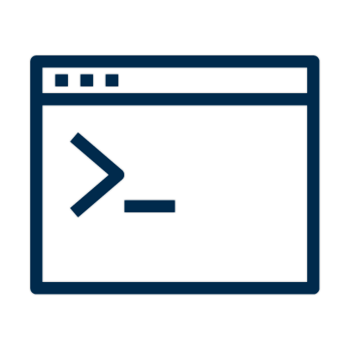


DevOps vs Security – The Perception
Dev
Dev
Sec
Ops
Notes:
Small teams working independently to implement their features, validating correctness in pre-production environments, with deployments into production happening predictably, quickly, safely, and securely, throughout the business day.
As a developer Cyber as a blocker; Using all the tools and code-snippets; department of “no”
As a DevOps lead Cyber as an impediment to innovation. Admin rights on every machine for deployments
As an Ops lead I saw Cyber as the reason my new features were taking so long to reach production.
As a Cyber Analyst I saw that I was an idiot…. policies are perceived as obstacles to be worked-around. Lackck of open engagement supported their clandestine reputation.
We hear a lot to talk about “shift-left” security. It’s a phrase I don’t particularly like, but it is important to know why, now more than ever, it matters. We as IT professionals are not the only ones “shifting-left”!

Slide 4





Scary Slide No.1
Notes:
Everyone here uses source control.
August 2019, GitHub in a US lawsuit Capital One breach. social security numbers to be stored in a Git repository.
October 2019, Starbucks left exposed an API key
January 2021, a misconfigured Git server at Nissan North America publicly exposed with a default username and password of admin/admin.
December 2022, Okta breach included the unauthorised downloading of source code use of stolen authorisation keys
Slack externally hosted GitHub repositories via a "limited" number of Slack employee tokens that were stolen.
Human error. Tooling on its own cannot guarantee that everything we do is secure … but they can help to protect us against ourselves.

Slide 5
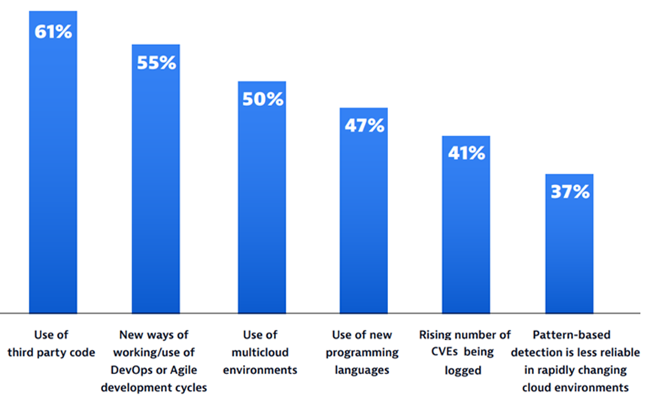
Scary Slide No.2
68%
of apps had a security flaw that fell into the OWASP Top 10
Notes:
CISOs were asked factors made it difficult to pinpoint and resolve application vulnerabilities.
61% 3rd party code caused issues. Log4J; not exposed; think about the dependencies
55% blamed DevOps and Agile; New innovations causing pain; Security to keep up!
Scans of 130,000 applications; 68% of apps had a security OWASP flaw; Broken access control at number 1; Injection number 3
So what can tooling do to help our CISOs sleep better and our developers to avoid some basic mistakes?

Slide 6
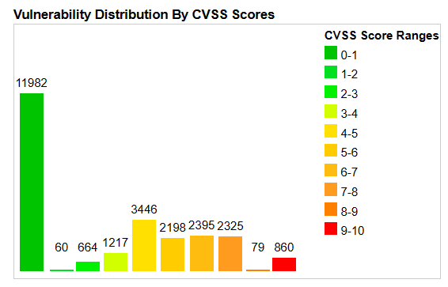
Scary Slide No.3
25,226
Common Vulnerabilities and Exposures (CVEs) were published last year alone.
57%
report that their breaches could have been prevented by installing an available patch
34%
victims knew of the vulnerability, but hadn’t taken action
Notes:
With a strong secure development culture. We can build reliable, repeatable, and secure deployments, but the work never ends.
25,226 CVEs last year alone; and increase of 25%; 70 per day; Already almost 5,000
3.4% (860) had a CVSS score between 9 and 10, the most critical.
State of Application Security report; 57% could have been prevented by installing an available patch; 34% knew of the vulnerability, but hadn’t taken action
74% of companies say they simply can’t patch fast enough because the average time to patch is 102 days

Slide 7

Where should Sec live?
Sec
Sec
Sec
Ops
Dev
Security Everywhere
Notes:
Create a culture of collaboration; earliest stages and running throughout the lifecycle.
Security, like testing, is an afterthought; Problems too late, moves forward, running at risk; Technical debt spiral; “We’ll fix this later”; Add in Cloud
As part of the culture change required to fully adopt DevSecOps, Security must work closely with Development and Operations, and most importantly, be an enabler. An important part of this is going to be the choice of tooling.

Slide 8



Vince’s Three “i”s of Tooling for Developer Enablement
Integrations
Intelligence
Insights
IDEs
Pipelines
Policies
Audit Mode
Speed
Sources
Zero days
Recommendations
Vendor data
Communication
Prioritisation
Custom Code/SBoM
Licences
Trending
Enterprise Visibility
Notes:
So, what should we be looking for?
Integrations
Developers complex creatures; Good problem solvers and enjoy a challenge; No bureaucracy; effort working around it; No interruptions; “constructive” feedback.
Integrate with their way of working close to the coalface, the better. Developers live in their IDE.
DevOps can’t rely on “well it works on my machine”; CI/CD pipelines; Don’t create blockages.
Create a safe space for Developers; Walled garden; Ability to create policies.
A quick side note of policies; Evidence-based policies are appropriate and pragmatic.
All or nothing; One day working, the next failing; Without understanding the impact. Able to run a “what-if” testing period.
There will always be a trade off between speed and accuracy; Understand risk tolerance; feel comfortable while remaining productive.
Intelligence
2022 16 high or critical vulnerabilities every week; A tool that aggregates NIST, NVD, SANS, OWASP, and the wider community to keep us informed.
Trend in how quickly vulnerabilities are being abused. Time to exploit; Zero days; Support with remediation steps is vital.
Explanations are complex; Developers “just tell me how to fix it”; Security don’t understand remediation; Tool provide technology-specific recommendations.
Huge amounts of data; Every scan, package reviewed, issue highlighted; feed back into the tool to improve recommendations and give confidence in remediations.
Vendors open with their findings; Annual reports; Participate in ethical disclosure programs… a rising tide lifts all ships!
Insights
Avoid alert fatigue; Concentrate; Low severity on every system; 1 critical worry about. Tooling must help us prioritise our work.
I’ve spoken a lot so far: Risks without context are meaningless. Notoriety generates actions CSIRT meetings; Log4j; 80% of code vital to understand complete Software Bill of Materials for your application.
Licence; Open source not free; Track package usage; Developers are not going to read the terms and conditions.
Got tooling, created the processes, building a strong culture, next metric; MttR, # criticals, successful builds; Compare to before; Are we getting better? Tooling should track these metrics and show trending data to help us justify our existence to senior managers!
Too often we don’t tell anyone; Advocate of highlighting the good; Share data with the whole company; Uncomfortable; Open, honest comms key to continuous improvement.
Ask me later about my year long project to passive aggressively improve our posture management.

Slide 9
Notes:
Something you agreed with, or sounded familiar; “DevSecOps is a journey” gives the impression of destination; DevSecOps eutopia.
To me DevSecOps is an adventure. There’ll be ups and downs, and we’ll most likely lose a few people along the way, but as long as we all understand the direction we are going in, striving to make things better, and are using the right mix of People, Processes, and Tooling, we can’t help but learn and improve.

